Slide 1
MEDT 8461: Project 3 – Interview 2
By: Canon Snow

Slide 2
Interviewee Information
Several 8th Grade Math Students from one of my math classes at Eastbrook Middle School were given a brief interview questionnaire regarding the current state of technology integration in their school.
Note* Though the names have been left off, the answers are aligned by student; so all answers listed by the number 1 are from the same student

Slide 3

Q. What is your definition of technology?
My definition of technology is computers or any electronic device to make life easier.
A component that has a processor
Something that uses electricity or that helps you.
Technology to me is a computer.
My definition of technology is computers, cell phones, iPods, ect...
Technology - an electronical item that we use in this time period.
Note* Apparently, computers and electronics are the only types of technology that exist. I did like the answer from #3 “or that helps you”.

Slide 4

Q. When you hear the phrase “technology integration” what does that mean to you?
At Eastbrook, technology isn't integrated well, compared to other schools.
How many pieces of technology you have.
blank
There is not much technology at Eastbrook.
At Eastbrook technology is not integrated very well.
the school having a bunch of the same technology.
Note* Based on the responses it seems I should have explained this concept a little better.

Slide 5
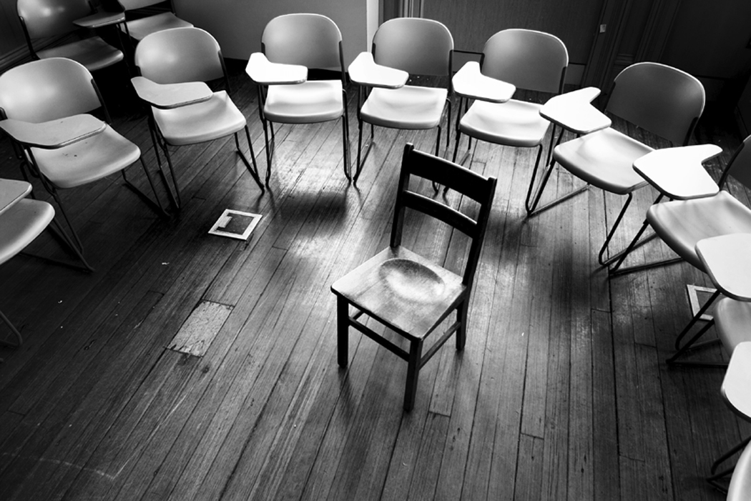

Q. How do you think technology affects the learning process?
Technology helps the learning process by creating engaging activities so more students will participate.
It helps because you might need to fix computers in the future.
yes
It makes learning easy.
Technology affects the learning process very fairly, because some students learn w/technology
Technology does affect the learning process because it helps us learn about the world.
Note* Mostly positive answers ☺

Slide 6

Q. How do you think technology should be used in school?
I think technology should be used more respectfully so we can have more in our school.
It should be used every day in class.
Technology should be used as much as possible.
To make school go faster.
Technology should be used to help students learn in school, using fun things.
We should use technology for learning and working.
Note* I didn’t get a lot of “how” but it is apparent they would like technology more integrated in the curriculum.

Slide 7
Q. How well do your teachers incorporate technology in your classes?
I don't understand what this question is asking.
Mr. Snow doesn't incorporate it instead he likes to pretend he is a robot.
Teachers don't use it.
They don't use technology.
Teachers use technology in class rarely.
Very well.
Note* There is a definite need for teachers to integrate more technology in their lessons, myself included. I would say that for some this is because of a lack of resources.

Slide 8
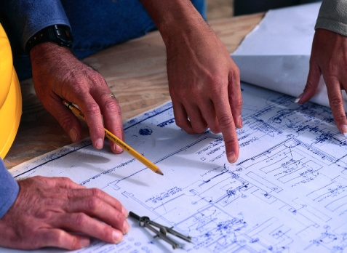

Q. If you could design your own classroom, what type of technology would be included in your design?
Note* I would happily teach in a classroom designed by students.
If I could decide the technology, I would choose computers, projectors, and smart boards.
There would be phones, game systems, computers, and flat screens in every corner.
Projector, Smart boards, (a nice color besides white) better desks.
A laptop for every desk
Laptops, projectors, smart boards would be used in my class.
Computer, projectors, printers, and laptops.

Slide 9



Q. Are you happy with the level of technology within your school?
No, I am not happy with the level of technology at EMS
No
No
No, I need more technology.
It really doesn't matter to me if we have technology in this school or not.
Sometimes
Note* I will side with students 1-4.

Slide 10
Q. Do you think you would learn more from lessons involving computers and Internet activities as opposed to a traditional lesson format (board, books, paper)?
If I am answering for just myself, I would say it doesn't make a difference because I'm the type of student who tries to learn all I can either way.
yes
Yes, because you can do things in a fun way.
yes
For me I really don't care, because I try my best at everything.
sometimes
Note* I think it is interesting that some students do not see a difference either way. This could be because they have not had many experiences with technology that they can compare.

Slide 11
Q. How would you rank your computer literacy on a scale of 1-10?
5
1
1
6
5
7

Slide 12
Final Thoughts
Click on the wma object.

